Slide 1
Middle School Open House 2022-2023
Mother Teresa of Calcutta Catholic School

Slide 2
WHAT’S New
Students will resume dressing out for PE; therefore, they will come to school in school uniform and change into their PE uniform.
NO STUDENT MAY CALL IN THE EVENT THEY FORGET THEIR PE UNIFORM.

Slide 3
Middle school expectations: *Writing in planner daily *Be prepared for each class *Self-advocate
6th Grade
7th Grade
8th Grade
Trimester 1
Write homework in planner for each class
Learn to access and navigate Educator Pages
Learn and practice One Note and to compose an email to a teacher
Check their personal email at least twice a day
Trimester 2 & 3
Use One Note proficiently
Write an email to a teacher
Approach teachers for any absent or missing work
Trimester 1
Access and navigate Educator Pages
Check their personal email at least twice a day
Use One Note proficiently
Write an email to a teacher
Approach teachers for any absent or missing work
Trimester 2 & 3
Strengthen all habits to be ready for the 8th Grade
Trimester 1, 2 & 3
Continue to strengthen habits from 6th and 7th grade to be ready for high school

Slide 4
Approaches to Learning (ATL)
The ATL Grade for each class will be:
recorded in Ren Web
details are viewable in RenWeb
You will see the ATL grade listed as a separate category. All students begin the trimester with a grade of 4. If the ATL grade drops, it will be adjusted in the gradebook.
Students receive an ATL grade in each class, including Specials.

Slide 5
Approaches to learning (ATL)
The following are the indicators of Organization, Communication/ Collaboration and Reflective Thinking.
Organization
Prepared for class
Punctual with homework and in-class assignments
Completed homework and in-class assignments
Collaboration & Communication
Participates in class
Attentive and engaged during instruction
Demonstrates helpfulness and teamwork
Reflection & Personal Initiative
Open to teacher help and correction
Makes effort to improve behavior/performance by seeking help when needed
Makes time for personal study and improvement

Slide 6
 | Organization | Collaboration & Communication | Reflective Thinking
4 Exceeds (0 to 2 ATLs) | Consistently displays readiness to learn through preparedness, punctuality and task completion. | Consistently attentive and engaged; participates well in class; works well in groups; seeks help when needed. | Consistently open to teacher feedback; reflects on how to keep improving; produces quality work; makes time for personal study and improvement.
3 Meets (3 to 7 ATLs) | Frequently displays readiness to learn through preparedness, punctuality and task completion. | Frequently attentive and engaged; participates well in class; works well in groups; seeks help when needed. | Frequently open to teacher feedback; reflects on how to keep improving; produces quality work; makes time for personal study and improvement.
2 Developing (8 to 13 ATLs) | Occasionally displays readiness to learn through preparedness, punctuality and task completion. | Occasionally attentive and engaged; participates well in class; works well in groups; seeks help when needed. | Occasionally open to teacher feedback; reflects on how to keep improving; produces quality work; makes time for personal study and improvement.
1 Rarely (14+ ATLs) | Rarely displays readiness to learn through preparedness, punctuality and task completion. | Rarely attentive and engaged; participates well in class; works well in groups; seeks help when needed. | Rarely open to teacher feedback; reflects on how to keep improving; produces quality work; makes time for personal study and improvement.

Slide 7
Grading policy
Summative Assessments 70%
Include test, projects and prolonged writing assignments
Trimester 1 and 3 exams count as one summative assessment each trimester
Formative Assessments 30%
Varies from teacher to teacher but students are informed when an assignment is a formative
Include but are not limited to quizzes, entrance/exit tickets and IXL.
Tests and quizzes will be posted on Educator Pages before the assessment.
There will be no more than 3 tests or quizzes on a day
EX: 2 tests and 1 quiz 1 test and 2 quizzes 3 quizzes

Slide 8
Grading policy
Letter Grade | Descriptor | % Score
A | The student provides evidence of deep understanding and fluent application of the target standard(s). | 90-100
B | The student is close to meeting the target standard(s). | 80-89
C | The student meets part of the target standard(s). | 70-79
D | The student is just beginning to address the basic ideas of the target standard(s). | 60-69
F | The student provides little to no evidence of addressing the target standard(s), including missing or incomplete work. | 50-59
The lowest earned grade is a 50%.
Assessments not attempted or handed within 3 days of the due date will receive zero points.

Slide 9
LATE WORK
All assignments are to be turned in on the due date. Assigned work is due at the beginning of class.
Late assignments will be accepted up to 3 days following the original due date for a maximum of 50%.
Late summative projects will be accepted up to 3 days following the original due date with a 15-point deduction for each day late.
Students will earn an ATL for each day the work is not submitted. After 3 days, the assignment is no longer accepted.

Slide 10
ABSENCE Work
Students are required to
Communicate with the teacher for absence work
Complete and turn in absence work to the teacher
Assignments
Students will have 3 calendar days to complete and submit missed assignments.
Following 3 calendar days, the makeup work is late and a grade of zero will be recorded.
Extended absences will be handled on an individual basis
Summative Assessments
Students absent on the day of a scheduled summative assessment will be expected to make it up upon his/her return to school.
For every day, a student is absent, he/she has that number of days to make up the summative assessment.
Planned Absences
Missed work will need to be obtained upon returning to school not prior to
Students will need to schedule with the teacher a date to make up any missed assessments and due dates for missed work.
If students miss the first part of the school day due to appointments or unforeseen circumstances, they must obtain work from their morning class teachers.

Slide 11
Retakes
Criteria for Summative Retake Eligibility
1. All students earning a 79% or below are eligible for a retake.
2. Retakes can earn up to an 80%
3. The higher grade will be recorded in the gradebook.
4. The retake assessment will cover all the same standards but may not be the same format.
5. The retake process MUST BE INITIATED BY THE STUDENT.
6. A paper copy of the Application for a Retake, test corrections and any subject specific forms should be completed by the student (with parent, if needed), signed by student and parent, and returned to the examining teacher no more than 2 school days after the test has been posted.
7. Students may be required to participate in additional practice to qualify for a retake.
8. Students are permitted to take a total of 3 retakes across all subjects per trimester.

Slide 12
Retakes: Limitations & Deadlines
All notes, assignments, and formative assessments must have been completed prior to the original summative assessment.
The retake for any summative in a unit must be completed before the date of the first summative of the following unit.
Semester/Trimester exams and summatives that are extended projects with ongoing feedback and clear completion deadlines do not qualify for retakes.
The student will forfeit the retake opportunity if either the scheduled retake date or a scheduled teacher required additional practice is missed, unless excused or rescheduled by the teacher. This will count against your trimester total.
Teachers reserve the right to deny a student from a retake before, during, or after the retake form is completed if the teacher can show due cause as to why there should not be a retake. This may include, but is not limited to, situations that involve academic dishonesty.
Notes:
Trimester Exams – this is to help prepare students for high school
Trimester 1: exam is on trimester 1 material
Trimester 2: exam is on trimester 2 material
Trimester 3: exam is on material for all year
Count as 1 test grade, cannot retake per Diocesan policy
There will be study guides for each exam

Slide 13
Retakes are administered on the next Tuesday after the Application for Retake has been submitted.
Retakes will be administered after school on Tuesday administered by teachers on a rotating basis.
Retakes will be held at the following times:
Morning Session (MTC athletes only): 7:00 – 7:45am in Ms. Whitaker’s classroom
Afternoon Session (all other students): 3:15 – 4:15pm in a designated classroom
Students participating in MTC sports or after school clubs are required to complete retakes in the morning
Retakes: Administration

Slide 14
Behavior Policy
The Diocese recognizes that the cultivation of good behavioral and learning habits and behaviors support learning in the long run. The following are the indicators of Respect and Responsibility:
Respect
Demonstrates a good attitude
Is respectful to adults and peers in speech and action
Maintains positive peer relationships
Respectful of personal, peer, and school property
Responsibility
Exhibits self-control
Follows directions and does not need constant reminders
Socializes only at appropriate times
Takes ownership for behavior

Slide 15
Conduct Expectations
1 demerit
3 demerits
6 demerits
Automatic Detention
Lack of self-control
Tardy to class
Excessive talking classroom/hall
Dress code violation
Chewing gum/eating in class
Not following directions
Out of seat w/out permission
Inappropriate use of technology
Sent out of class for behavior
Disrupting learning of others
Disrespect to property/person
Dishonesty/cheating/copying assignments
Conduct that is un-Christian or contrary to the character of a Catholic School

Slide 16
common violations
Dress Code (1 Demerit)
Hair length---too long
No belt
Skirt length is shorter than 2 inches from mid-knee
White socks with logos and/or non-white socks
Uniform fits inappropriately
Non-school outerwear
Nail polish, fake nails, or make up
Smart watches
Jewelry---Please see handbook
Inappropriate Use of Technology (3 Demerits)
Anything you doing on your device without permission from the teacher.

Slide 17
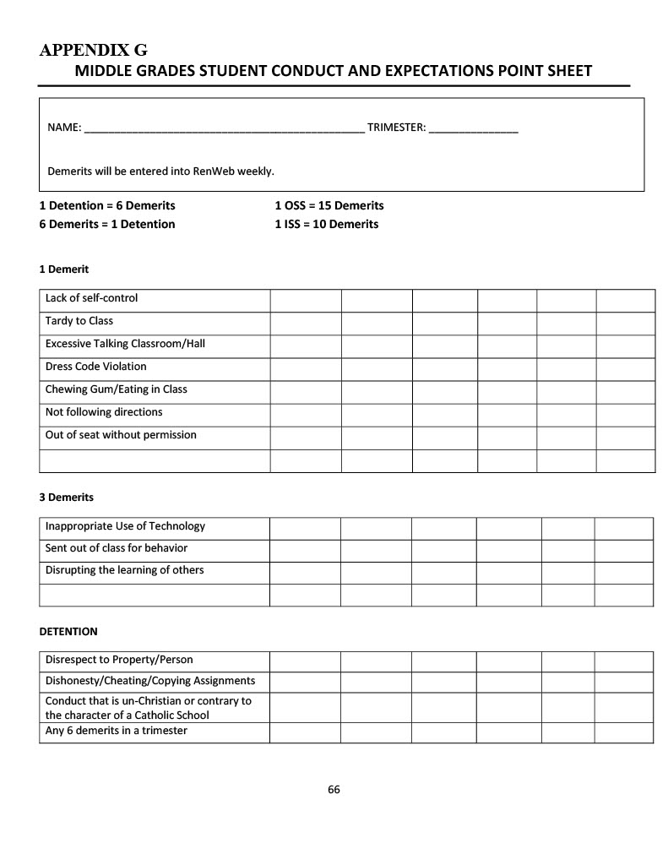
Conduct Expectations
Violation= 1 Demerit
6 Demerits= 1 Detention
1 In School Suspension = 10 Demerits
1 Out of School Suspension = 15 Demerits

Slide 18
Behavior Policy: Reporting Rubric
Conduct Grade | Respect | Responsibility
4 Exceeds 0 - 2 demerits in a trimester. | Consistently respectful, kind and cooperative. | Consistently follows school/classroom rules and directions.
3 Meets 3 - 7 demerits in a trimester. | Frequently respectful, kind and cooperative. | Frequently follows school/classroom rules and directions.
2 Developing 8 - 13 demerits in a trimester. | Occasionally respectful, kind and cooperative. | Occasionally follows school/classroom rules and directions.
1 Rarely 14+ demerits in a trimester. | Rarely respectful, kind and cooperative. | Rarely follows school/classroom rules and directions.

Slide 19
Field trip eligibility & incentives
Students who earn a 3 or above in conduct (0 to 7 demerits) are eligible to attend field trips scheduled for the current trimester.

Slide 20
Communication
Homework, Quizzes and Tests will be listed on Educator Pages
Changes or additions will be noted in student planner
Student will need to see teacher for classwork
Notification of demerits earned or other behavior events will be emailed to parents.
Parent Teacher conference dates:
11/4/2022
3/24/2023
Grades will be updated weekly and can be accessed 24/7 via RenWeb.
Progress reports and report cards are emailed.

Slide 21
National Junior Honor Society (NJHS)
Eligibility Requirements
Be enrolled in 7th or 8th grade.
Minimum of all A’s and one B during the first two trimesters of current school year.
Minimum of all 3’s in Conduct and Approaches to Learning during the first two trimesters of current school year.
Application Process
Each candidate will write an essay explaining how he/she demonstrates the qualities of service, leadership, citizenship, and character in addition to completing an application form.
The faculty advisory committee will utilize the following rubric to evaluate each candidate based on academic records, information provided in the essay and completed application form, as well as their knowledge of the student. The advisory committee will then vote on each candidate. Candidate’s receiving 70 % of the votes will be inducted.
Notes:
Grade 7 & 8 Only

Slide 22
National Junior Honor Society: APPLICATION RUBRIC
Notes:
Grades 6 - 8

Slide 23
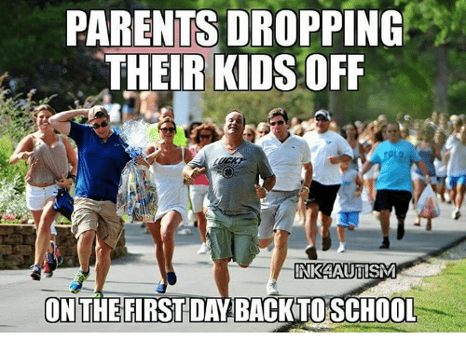
We look forward to a successful and rewarding year!

